Slide 1
Rendering Niftis in WebGL
Nick DeSisto

Slide 2
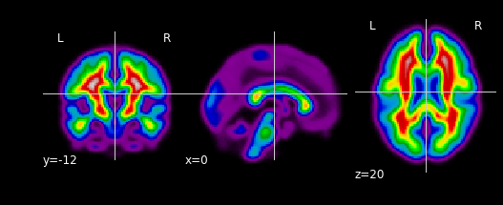
Converting Nifti ( .nii ) to .ply
Start with .dicom ; single slices
MRIcron is a matlab library for viewing and manipulating Nifti Images
Marching cubes
Nifti files are the defacto standard for fMRI analysis
Series of 3D matrices
We want to detect the edge of the brain and tesselate
MRIcron provides the facility to do this

Slide 3
.ply -> .obj
Ply is a binary file type ; hard to parse
Meshlab is used for conversion from ply to obj
Edge decimation is also performed to improve performance

Slide 4
Automating the process
####
#
# OBJ File Generated by Meshlab
#
####
# Object mesh.obj
#
# Vertices: 2728
# Faces: 5452
#
####
v -15.017035 -97.497192 6.881621
v -19.743319 -95.793076 8.963815
v -16.852465 -97.951149 2.004730
v -14.000000 -96.238098 12.000000
v -13.078869 -96.485519 2.871388
v 20.958668 -96.411682 4.701960
v -12.026178 -96.700882 9.599809
v -16.952421 -95.936340 -5.061333
v 21.045591 -96.473610 1.812083
v 17.986702 -95.872787 6.759920
v -20.000000 -96.062500 -6.000000
v -22.191980 -96.221519 -2.542200
…...
Script that takes nifti as param and outputs javascript array files
Written in python
Calls matlab and meshlabserver
The .obj file is parsed into javascript array files in python

Slide 5
Rendering in WebGL
Rendering techniques are similar to those for the other class projects
Interface uses jQuery for continuous slider updates to view

Slide 6
Improvements
Segmentation
White matter / grey matter mapping would provide a much better illustration
slicing
Deflation / inflation
Deploy to web (file uploading)

